Slide 1
Evaluating the Robustness of Invisible Watermarking Against Adversarial Attacks in Deepfake Detection
Cat Lewin | Dr. Rui Duan | UMKC NSF REU 2025
Week 4: June 16-22

Slide 2
Problem Statement
This project aims to examine the resilience and robustness of invisible image watermarks to adversarial manipulation, and their reliability in support of proactive deepfake detection.
Goal: Evaluate the resilience of watermarking methods against various image distortions and adversarial attacks.

Slide 3
Research Questions & Hypotheses
Research Questions:
How robust are perceptual watermarks under attack?
What are the trade-offs between imperceptibility vs resilience?
Can certain transformations reliably remove or degrade embedded watermarks?
Hypotheses:
Adversarial attacks will degrade watermark detection accuracy, particularly when designed to preserve perceptual fidelity.
Hybrid watermarking techniques (e.g., DWT-DCT-SVD) will outperform simpler methods under distortion attacks.

Slide 4
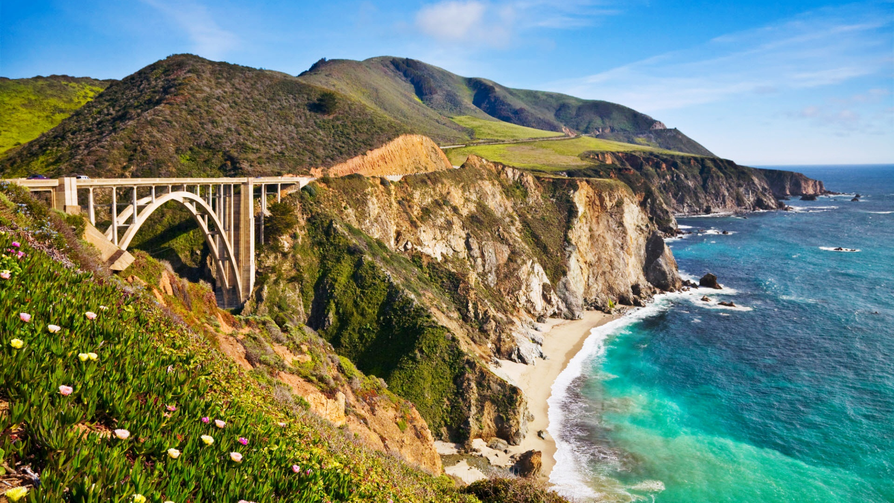
What Is Invisible Watermarking?
Original Image
Host Image + Watermark Input: Input image embedded with a binary watermark (e.g., 64 bits)
Output: Watermarked Image Visually identical to original
Decoding Phase
A decoder extracts the watermark
Robustness evaluated via bitwise accuracy and image similarity metrics
Used for:
Copyright protection
Deepfake traceability
Embed Watermark (e.g. 64 bits
Decode & Extract Watermark

Slide 5
How Is Invisible Watermarking Applied?
Frequency-Domain:
DWT (Discrete Wavelet Transform): Breaks the image into frequency subbands:
LL (low-low), HL (high-low), LH (low-high), HH (high-high)
DCT (Discrete Cosine Transform): Converts image blocks (usually 8×8) from spatial domain to frequency domain
Focuses energy into a few low-frequency coefficients
Common in JPEG compression
Neural Method: using a convolutional neural network (CNN)
Encoding: A neural encoder learns how to embed a binary watermark into an images pixels in a way that is invisible to the human eye.
Decoding: A neural decoder is trained to extract the watermark from an images pixels.

Slide 6
The 3 Watermarking Models Used
Frequency-Domain:
DWT-DCT: Frequency domain technique using wavelets and cosine transform (64-bit).
DWT-DCT-SVD: Adds singular value decomposition for numerical stability (64-bit).
Neural Method:
RivaGAN: Deep learning approach using a GAN-style encoder/decoder (32-bit).

Slide 7
Experimental Design Table
Experiment | Model | Dataset | Metric | Baseline | Expected Outcome
Exp1 | DWT-DCT | CelebA | SSIM, Decode Accuracy | Unattacked Image | Degradation under blur, resize
Exp2 | DWT-DCT-SVD | CelebA | SSIM, Decode Accuracy | Unattacked Image | More robust than DWT-DCT
Exp3 | RivaGAN | CelebA | Decode Accuracy | Unattacked Image | Most resilient under all conditions

Slide 8



Attack | Image | dwtDct | dwtDctSvd | rivaGan
No Attack |  | ✅ | ✅ | ✅
JPEG Compression Reduces image quality by removing high-frequency data. Common in real-world file sharing |  | ❌ | ❌ | ✅
Resize Changes the image dimensions and may involve interpolation. Affects pixel alignment Tests watermark resilience to scaling and resolution changes |  | ✅ | ✅ | ✅

Slide 9

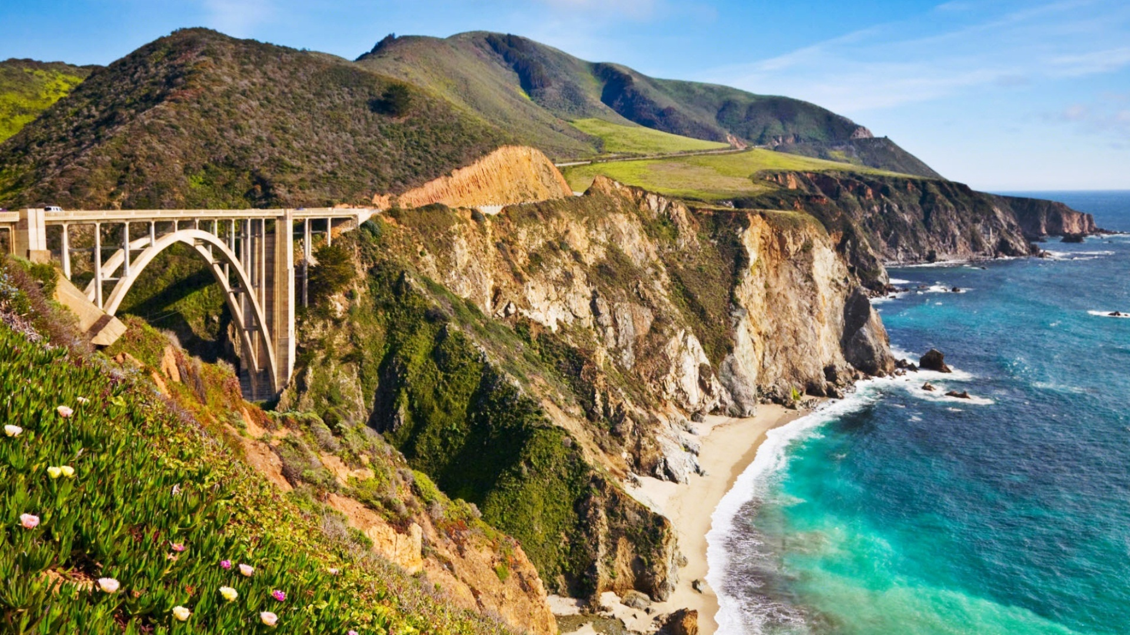
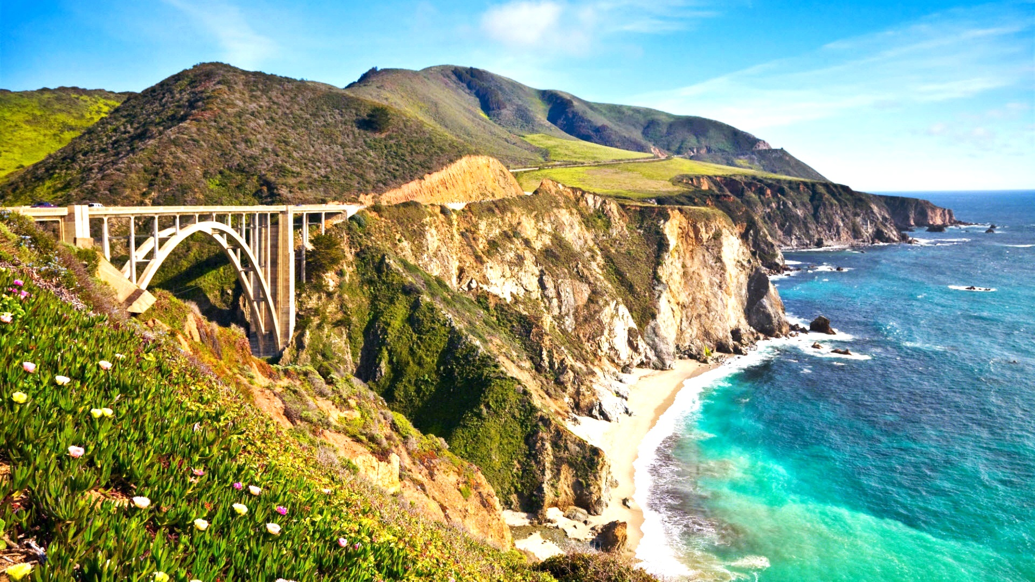
Attack | Image | dwtDct | dwtDctSvd | rivaGan
Gaussian Noise Adds random noise sampled from a normal distribution. Simulates sensor noise or transmission errors Challenges decoder sensitivity |  | ✅ | ✅ | ✅
Crop Removes a portion of the image. Permanently deletes parts of the watermark Tests whether the watermark remains recoverable from a partial image |  | ❌ | ❌ | ✅
Brightness Uniformly increases or decreases pixel intensity. Evaluates resistance to lighting changes |  | ✅ | ❌ | ✅

Slide 10

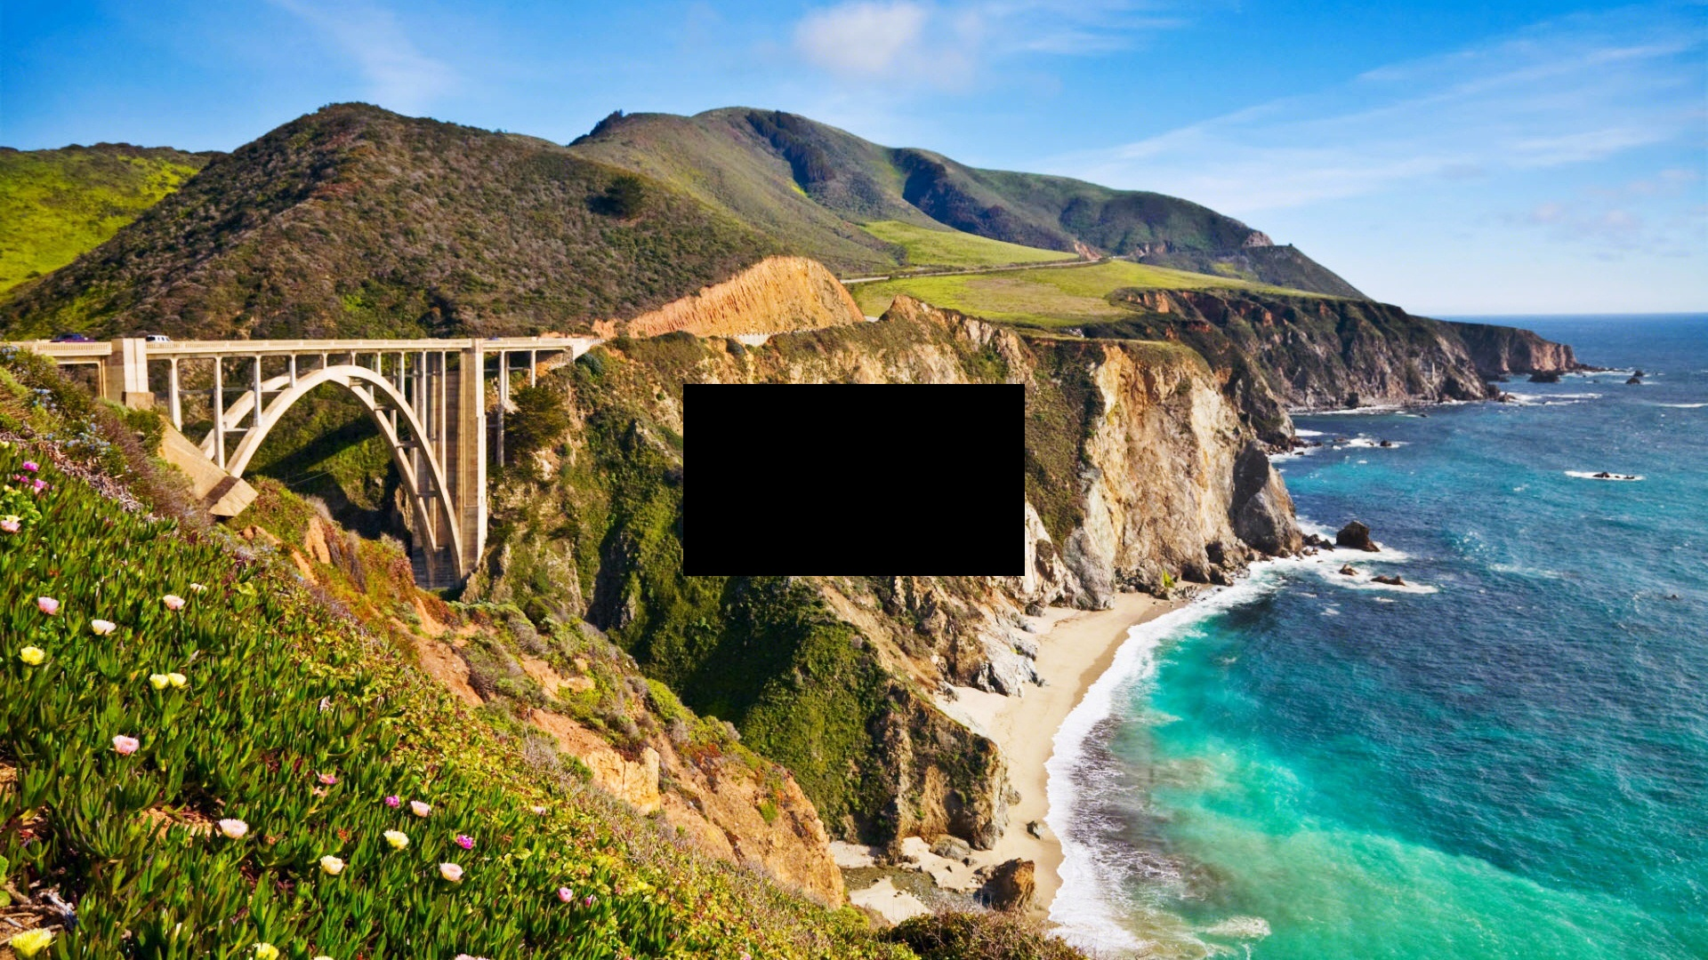
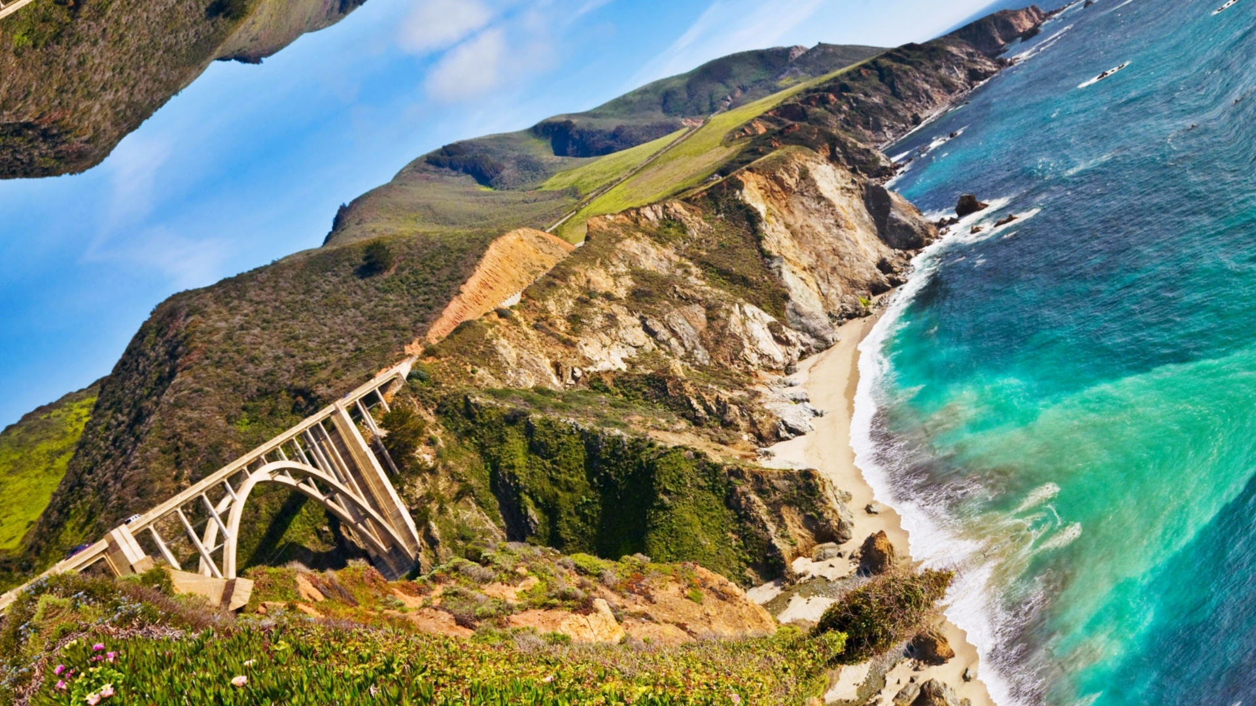
Attack | Image | dwtDct | dwtDctSvd | rivaGan
Overlay Adds another visual element (e.g., emoji or logo) on top of the image. Simulates social media modifications |  | ✅ | ✅ | ✅
Mask Applies a region of obstruction (e.g., blackout or blur) to the image. Mimics attempts to block or remove watermarked content |  | ✅ | ✅ | ✅
Rotate Rotates the image by a specified angle (e.g., 30°). Disrupts spatial orientation Tests decoder’s spatial invariance and robustness to geometric transformations |  | ❌ | ❌ | ❌

Slide 11
Comparison With Author Results
ShieldMnt claimed:
JPEG, noise, brightness, overlay, mask = PASS
Crop, resize, rotate = FAIL (for Freq method)
My reproduction confirms:
RivaGAN is robust to crop, JPEG, brightness
Classical methods fail more often under distortion

Slide 12
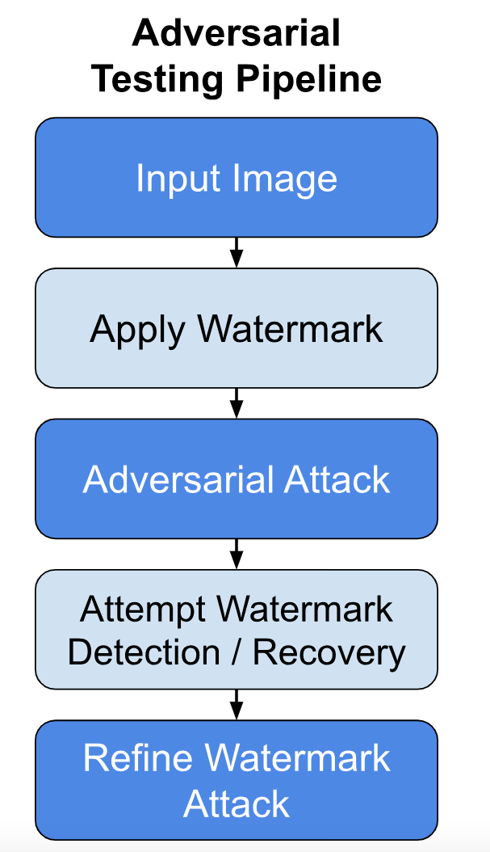
Reflections & Next Steps
Next:
Scale up to CelebA images
Add deepfake-specific attacks
Quantify perceptual loss (e.g., SSIM, PSNR)
Revisit LampMark when CelebA-HQ access is granted

Slide 13
References
[1] T. Wang, S. Yang, and Y. Wang, LampMark: Proactive Deepfake Detection via Training-Free Landmark Perceptual Watermarks, Proceedings of the ACM International Conference on Multimedia (MM), 2024. [Online]. Available: https://dl.acm.org/doi/10.1145/3664647.3680869
[2] H. Zhang, Y. Liu, C. Yu, J. Chen, and Y. Chen, Robust Invisible Video Watermarking with Attention, arXiv preprint arXiv:1909.01285, 2019. [Online]. Available: https://arxiv.org/pdf/1909.01285
[3] T. Karras, T. Aila, S. Laine, and J. Lehtinen, Progressive Growing of GANs for Improved Quality, Stability, and Variation, arXiv preprint arXiv:1710.10196, 2018. [Online]. Available: https://arxiv.org/abs/1710.10196
[4] K. T. Patil and S. A. Patil, Robust and Secure Watermarking Scheme Based on DWT-DCT-SVD with Matrix Encryption for Medical Images, Journal of King Saud University – Computer and Information Sciences, Elsevier, 2023. [Online]. Available: https://doi.org/10.1016/j.jksuci.2022.10.020

